Slide 1
Christopher B. Barrett Cornell University roundtable discussion on “When Is A Free Lunch A Good Idea?” February 3, 2019
When Is A Free Lunch A Good Idea?
Cash vs. Food-Based Approaches

Slide 2
Growing challenges
It helps to unpack by the four pillars of food security:
Availability: Food must be available in sufficient quantities. Supply-side necessary condition based on production, carryover stocks, trade, and aid.
Access: People must be able to acquire adequate healthy food. Demand-side necessary condition based on purchase, gifts, and safety nets.
Utilization: Translates food accessed into positive health impacts via cooking, storage and hygiene practices, WASH, and intra-hh allocation.
Stability: Must be able to maintain access and utilization over time, through lean seasons, disasters, price spikes, etc. Resilience is key.
A ‘free lunch’ aims to simultaneously address availability (lunch provided) and access (free), and sometimes utilization/stability.

Slide 3
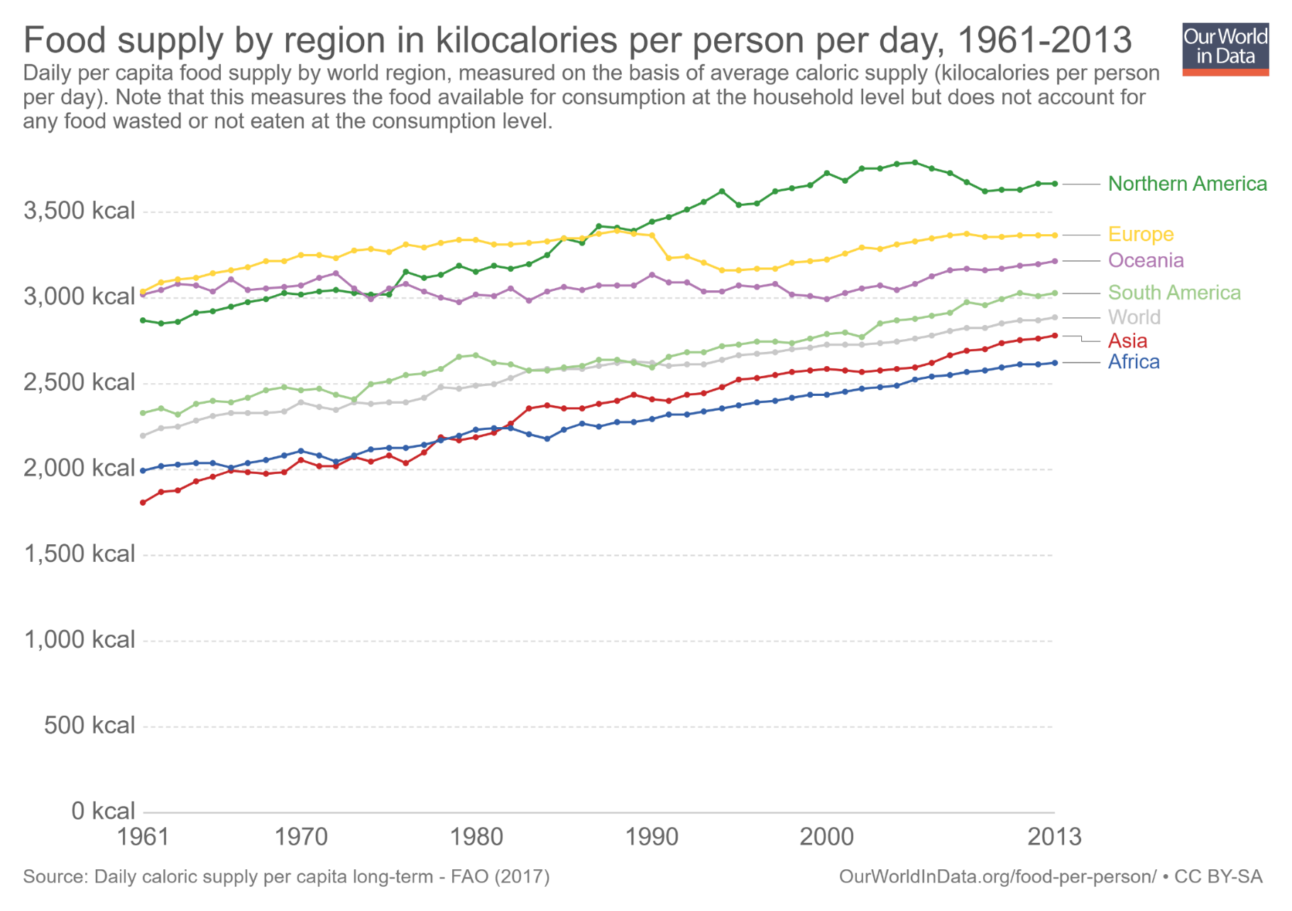
Availability rarely an issue
No longer aggregate-level calorie availability shortfall
2011-13 min. dietary energy req’t [1770,2340]

Slide 4
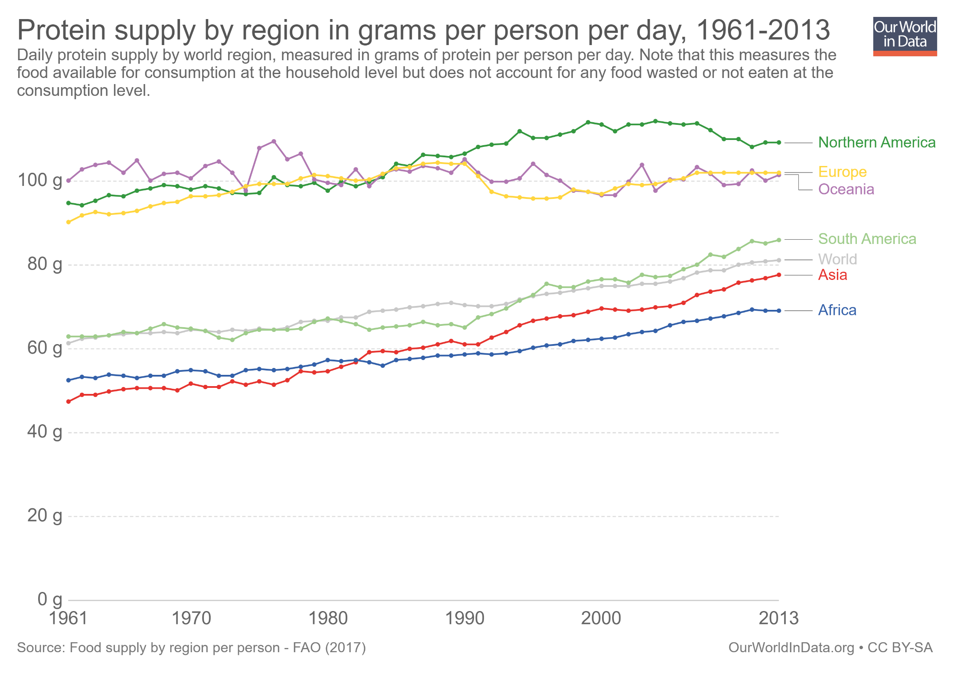
Availability rarely an issue
… likewise for protein availability
Daily protein req’t:
45-55 g/day global avg
(0.8 g/kg body weight)

Slide 5
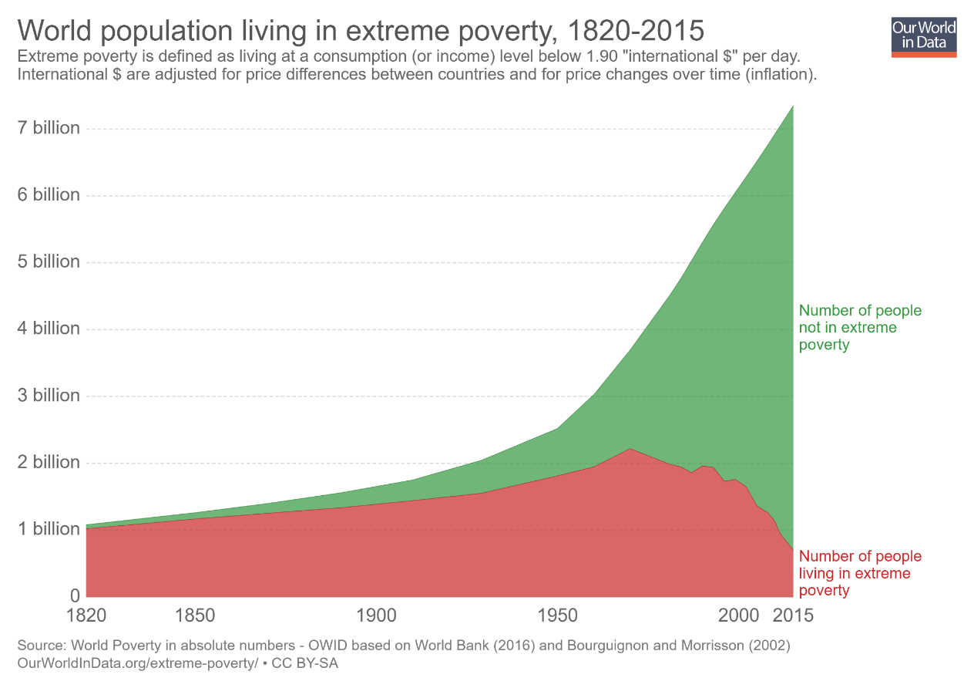
The main issue is access
“Starvation is the characteristic of some people not having enough food to eat. It is not the characteristic of there being not enough food to eat.” (emphasis in original)
- Opening sentences, Amartya Sen, Poverty and Famines, 1981
Poverty is the key driver of food insecurity. Historically unprecedented decline in global poverty has greatly improved food access.
But far too many suffer poverty still. And most of the poor do not live in low-income countries!

Slide 6
Safety nets for access, utilization, and stability
Safety nets dramatically expand access for the poor:
130 countries now have at least one non-contributory unconditional cash transfer program (Bastagli et al. ODI 2016)
~1.5 bn benefit globally from gov’t-financed food assistance programs (partly in-kind) (Alderman et al. 2018)
Employment guarantee schemes ensure people have access to a paying job (India’s is a constitutional right!)
Emergency response advances by humanitarian organizations have dramatically improved early warning and targeting, and accelerated response times.
Most programs run on cash, not food, to maximize impact

Slide 7
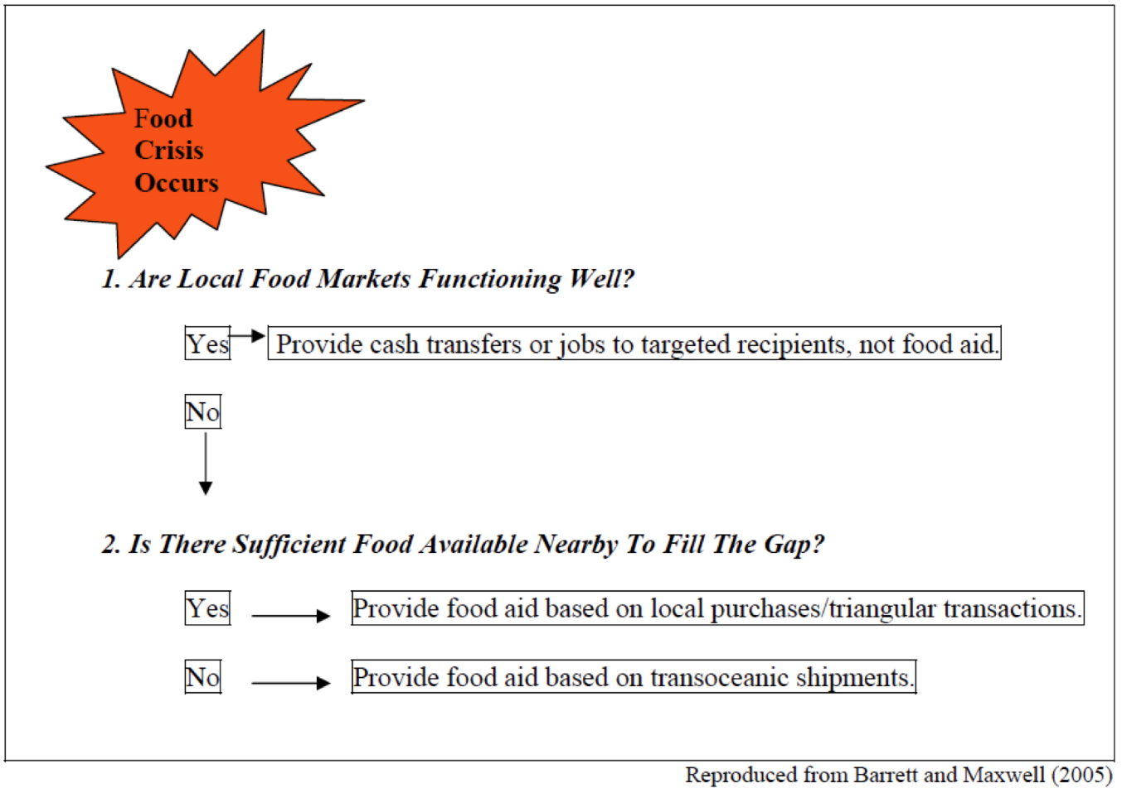
Cash or food? If food, shipped or buy local?
Best practice involves “response analysis” to determine how best to respond to a target beneficiary population’s food security needs

Slide 8
Cash typically best
Why favor cash-based programs (cash transfers, food vouchers, jobs, or locally purchased foods)?
Research partnership with Catholic Relief Services, Land O’Lakes, Mercy Corps and World Vision (LRP Learning Alliance) established strong evidence that on average cash or local/regional food purchases (vs. shipments from US):
Reduce delivery delays by 14 weeks
Reduce basic grains costs >50% (less for processed foods)
No effect on price levels/volatility in source markets
Recipient consumers prefer local over imported foods
At least comparable quality/safety to US products
Can benefit smallholder farmer suppliers
So cash/LRP/jobs are the preferred default response.

Slide 9
Food sometimes best
What are the exceptions when food is favored?
When people/governments won’t contribute cash.
When food availability is limited by infrastructure damage that disrupts commercial supply chain:
Ex: earthquakes in Nepal, Pakistan; flooding in Guatemala, northern Kenya
When specialty foods are needed and cheaper to send
Ex: therapeutic foods; fortified veg oil
When local market scale insufficient to source food needs without sparking inflation.
There are some contexts in which ‘a free lunch’ shipped from the US is best. But cash/jobs/locally sourced foods are usually the best response.

Slide 10
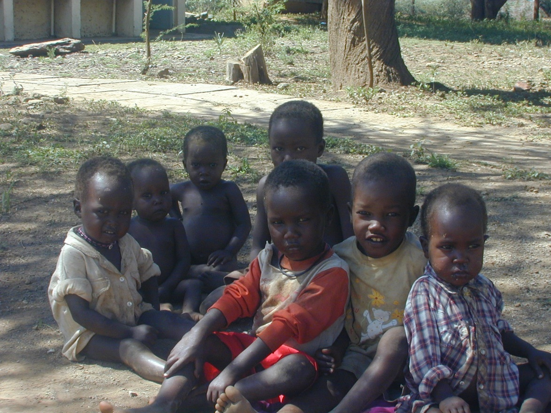
Thank you
Thank you for your time, interest and comments!

